Slide 1

Birds Strike Analysis (2000- 2011)
Time Series Analysis, Airlines-airports, Altitude-phase of Flight, Impact by Stike Analysis

Slide 2
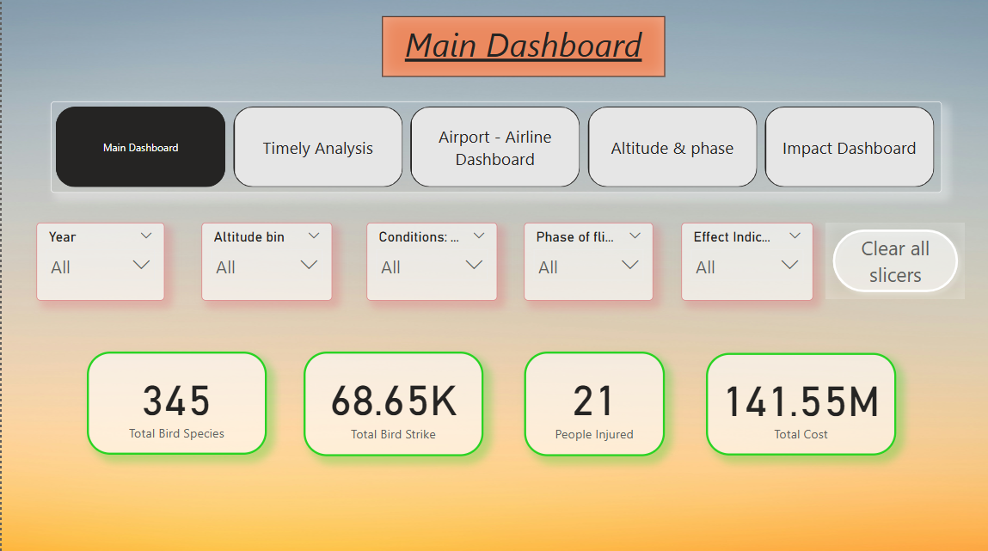
Birds Strike Analysis (2000-2011)
- Overview of main KPI’s for bird's strike

Slide 3
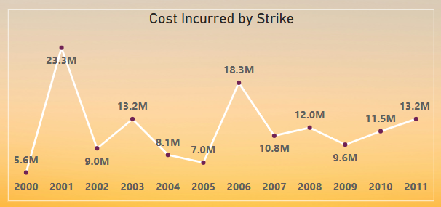
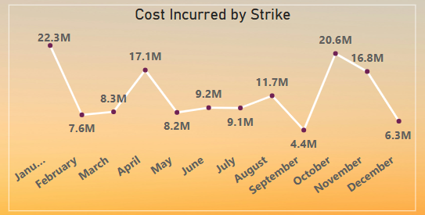
Time Series Analysis (2000-2011)
2001, 2006, 2011 were highest cost incurred by bird’s strike
January, April, October, November are recorded as highest Cost incurred by strikes.

Slide 4
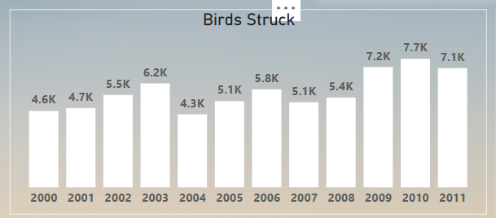
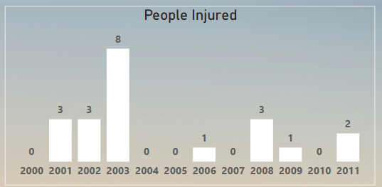
Yearly Strike and people injured
2009,10,11 were highest bird’s strike happened.
2003 were recorded most injured people.
2001,02, 08 has three people injured and rank at 2nd

Slide 5
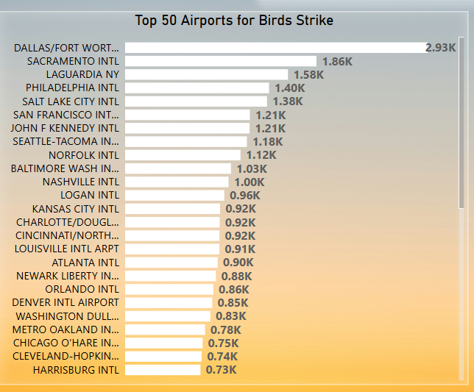
Airport and Bird Strike
- Dallas/Fort recorded highest bird strike at rank 1st.
- Sacramento, LaGuardia at rank 2nd and 3rd place respectively.

Slide 6
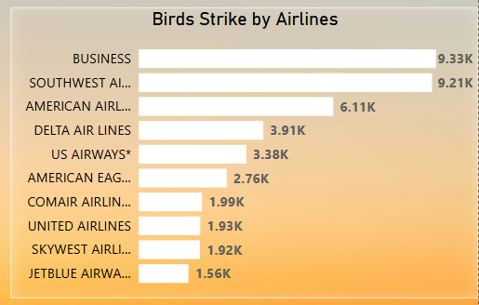
Airline and Bird Strike
Business and Southwest Airlines are top 2 Birds strike Airlines recorded.
American Airlines is at rank 3rd .
Jetblue Ariways was at last rank.

Slide 7
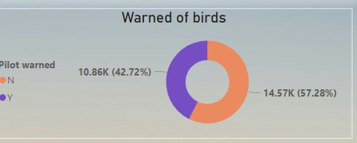
Warning About Bird Strike
Warned is 43 %
Not Warned is 57 %

Slide 8
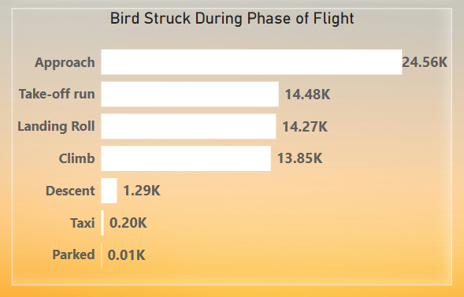
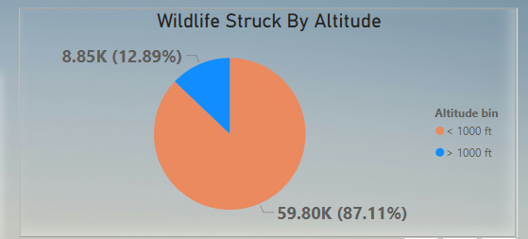
Altitude and Phase of flight
Most of Stike happened at time of Approach of flight. Parked phase has least strike
Most of Strike Happened at altitude of less than 1000 Feets.

Slide 9
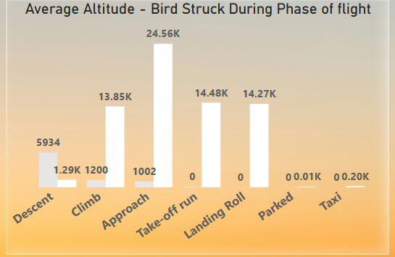
Altitude and Phase of flight
- Most of Stike happened at time of Approach of flight. And Average altitude of 1000 Feet.
- Climb phase recoded at high stike average altitude of 1200 Feets

Slide 10
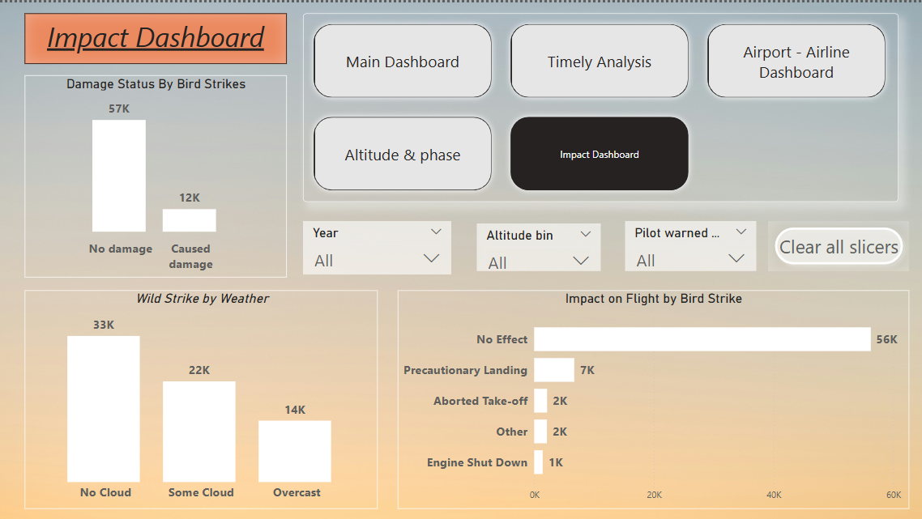
Impact by Birds Strike
Most of time is No Damage Caused.
Most of Stike happened when Sky was clear.
Most of time ‘No Effect’ was recorded after bird’s stike.

Slide 11
Thank You

